Slide 1
国 际 贸 易 实 务
第十章：综合制单实操
Presented by: Grace Tan

Slide 2
目录
综合制单实操、单击此处添加文本标题
2、单击此处添加文本标题
3、单击此处添加文本标题
总复习击此处添加文本标题

Slide 3
第一节：综合制单实操
实训场景：广州莱特电子科技有限公司（Guangzhou Light Electronic Teleological Corporation）是一家专门从事生产LED灯及LED控制器的外贸出口公司。公司地址为：广州市天河区东圃镇光明路99号，电话：020-8956343 传真：020-8956435，公司编号为：3056721780，出口许可证编号为：SZGZ986342. 出口的LED灯具的商品编码为：94054090.
近期外贸业务员陈蕙（Cathy）新开发了美国纽约的一位客户，该客户英文名字为TOMMY，在OCAK INTERNATIONAL LIGHTING CORPORATION担任国外采购。该公司主要从事全球灯具的采购和销售业务。
以下为TOMMY最近和陈蕙的往来邮件，请根据邮件信息，帮助陈蕙制作销售合同（合同编号为202000450521），商业发票（商业发票编号为202009802245）及回复邮件给TOMMY，告知相关单据已经制作好，请他把信用证也及时开立好发给我们，如有任何疑问或者要求请及时电邮通知。

Slide 4
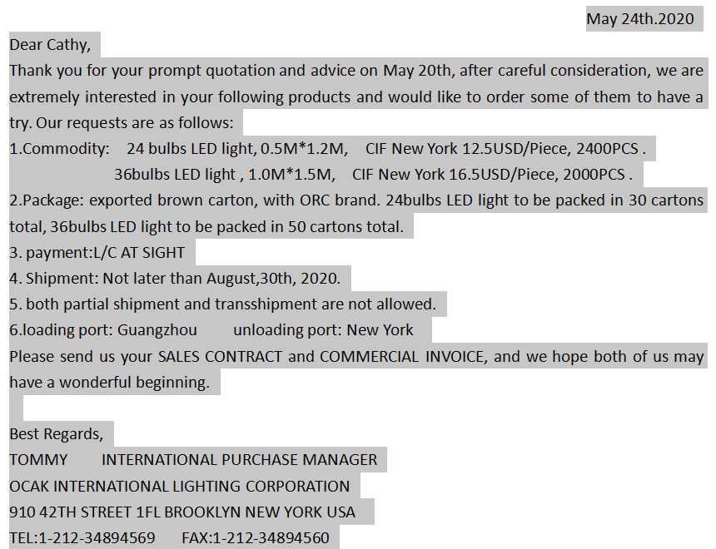

Slide 5
销售合同SALES CONTRACT
卖方SELLER: |  | Guangzhou Light Electronic Teleological CorporationAddress：NO.99 Guangming Road, Dongpu Town,Tianhe District, Guangzhou, China.Telephone：020-8956343 Fax：020-8956435， |  |  |  |  |  |  |  | 编号NO.: | 202000450521
 |  |  |  |  |  |  |  |  |  | 日期DATE: | May 25th.2020
 |  |  |  |  |  |  |  |  |  | 地点SIGNED IN: | GUANGZHOU, CHINA
买方BUYER: |  | OCAK INTERNATIONAL LIGHTING CORPORATION910 42TH STREET 1FL BROOKLYN NEW YORK USA TEL:1-212-34894569
买卖双方同意以下条款达成交易：This contract Is made by and agreed between the BUYER and SELLER , in accordance with the terms and conditions stipulated below.
1. 品名及规格Commodity & Specification |  |  |  |  |  | 2. 数量Quantity |  |  | 3. 单价及价格条款Unit Price & Trade Terms |  | 4. 金额Amount
24 bulbs LED light, 0.5M*1.2M36bulbs LED light , 1.0M*1.5M |  |  |  |  |  | 2400PCS2000PCS |  |  | CIF New York 12.5USD/PieceCIF New York 16.5USD/Piece |  | USD30,000USD33,000
Total: |  |  |  |  |  | 4400PCS |  |  |  |  | USD63,000
允许With |  |  | 溢短装，由卖方决定More or less of shipment allowed at the sellers’ option
5.总值Total Value |  |  |  | SAY US DOLLARS SIXTY THREE THOUSAND ONLY
6.包装Packing |  |  |  | exported brown carton, with ORC brand. 24bulbs LED light to be packed in 30 cartons total, 36bulbs LED light to be packed in 50 cartons total.
7.唛头Shipping Marks |  |  |  | OCAKILCNEWYORK202000450521NO.:1-80
8.装运期及运输方式Time of Shipment & means of Transportation |  |  |  |  |  |  | Not later than August,30th, 2020 BY SEA
9.装运港及目的地Port of Loading & Destination |  |  |  |  | FROM GUANGZHOU TO NEWYORK
10.保险Insurance
11.付款方式Terms of Payment |  |  |  | L/C
12.备注Remarks
The Buyer |  |  |  |  |  |  |  | The Seller
OCAK INTERNATIONAL LIGHTING CORPORATION |  |  |  |  |  |  |  | Guangzhou Light Electronic Teleological Corporation
(signature) |  |  |  |  |  |  |  | (signature)

Slide 6
Guangzhou Light Electronic Teleological CorporationAddress：NO.99 Guangming Road, Dongpu Town,Tianhe District, Guangzhou, China.Telephone：020-8956343 Fax：020-8956435，
COMMERICALINVOICE
TO: | OCAK INTERNATIONAL LIGHTING CORPORATION910 42TH STREET 1FL BROOKLYN NEW YORK USA TEL:1-212-34894569 |  |  |  |  |  | INVOICE NO.: |  | 202009802245
 |  |  |  |  |  |  | INVOICE DATE: |  | May 25th.2020
 |  |  |  |  |  |  | S/C NO.: |  | 202000450521
 |  |  |  |  |  |  | S/C DATE: |  | May 25th.2020
TERM OF PAYMENT: |  |  |  | L/C
PORT TO LOADING: |  |  |  | GUANGZHOU
PORT OF DESTINATION: |  |  |  | NEWYORK
TIME OF SHIPMENT: |  |  |  | Not later than August,30th, 2020
Marks and Numbers |  |  | Number and kind of packageDescription of goods |  |  | Quantity |  | Unit Price |  |  | Amount
OCAKILCNEWYORK202000450521NO.1-80 |  |  | 24 bulbs LED light, 0.5M*1.2M36bulbs LED light , 1.0M*1.5M |  |  | 2400PCS2000PCS |  | CIF New York 12.5USD/PieceCIF New York 16.5USD/Piece |  |  | USD30,000USD33,000
 |  |  |  |  | Total Amount: | 4400PCS |  |  |  | USD63,000
SAY TOTAL: |  | SAY US DOLLARS SIXTY THREE THOUSAND ONLY
MAY 26th, 2020

Slide 7
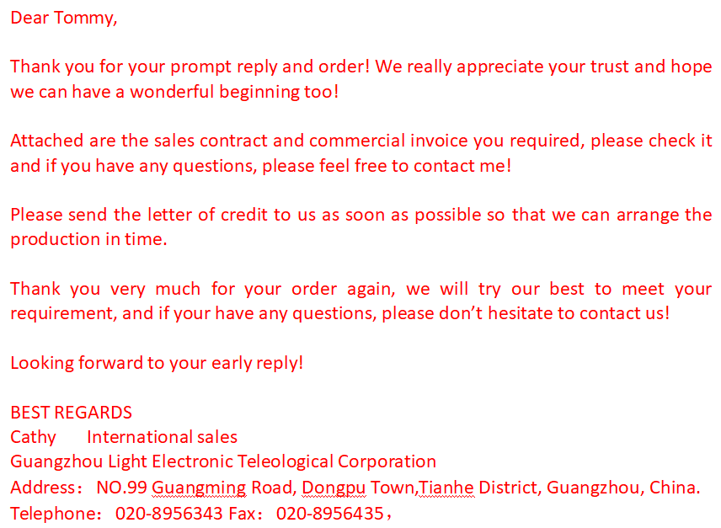

Slide 8
Dear Tommy,
Thank you for your prompt reply and order! We really appreciate your trust and hope we can have a wonderful beginning too!
Attached are the sales contract and commercial invoice you required, please check it and if you have any questions, please feel free to contact me!
Please send the letter of credit to us as soon as possible so that we can arrange the production in time.
Thank you very much for your order again, we will try our best to meet your requirement, and if your have any questions, please don’t hesitate to contact us!
Looking forward to your early reply!
BEST REGARDS
Cathy International sales
Guangzhou Light Electronic Teleological Corporation
Address：NO.99 Guangming Road, Dongpu Town,Tianhe District, Guangzhou, China.
Telephone：020-8956343 Fax：020-8956435，

Slide 9
第二节：总复习
详情见模拟习题

