Slide 1
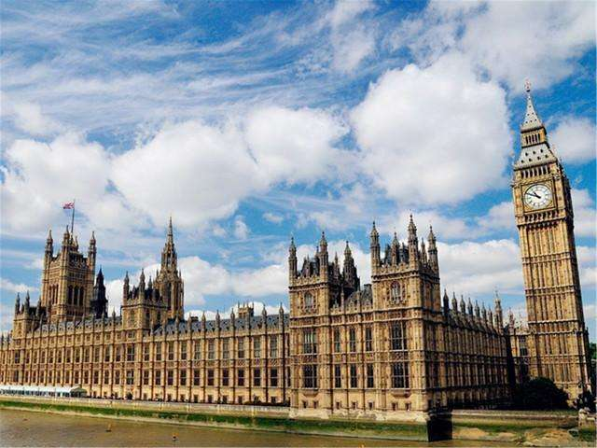
英语国家社会与文化
The Society and Culture of English-Speaking Countries
主 编：杨筱霞

Slide 2
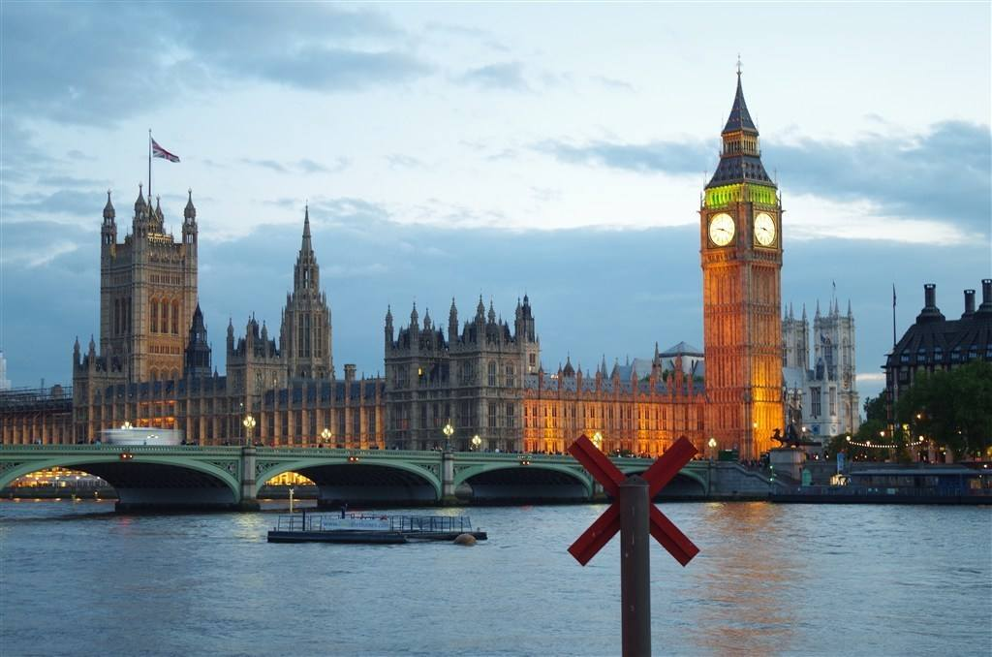
2
Chapter
The United States of America
Learning Objectives
• Master the key facts of America.
• To have ideas of vocational education and tourism in America.
• To find out interesting food habits of Americans.
• Make an oral report about the characteristics of America.

Slide 3
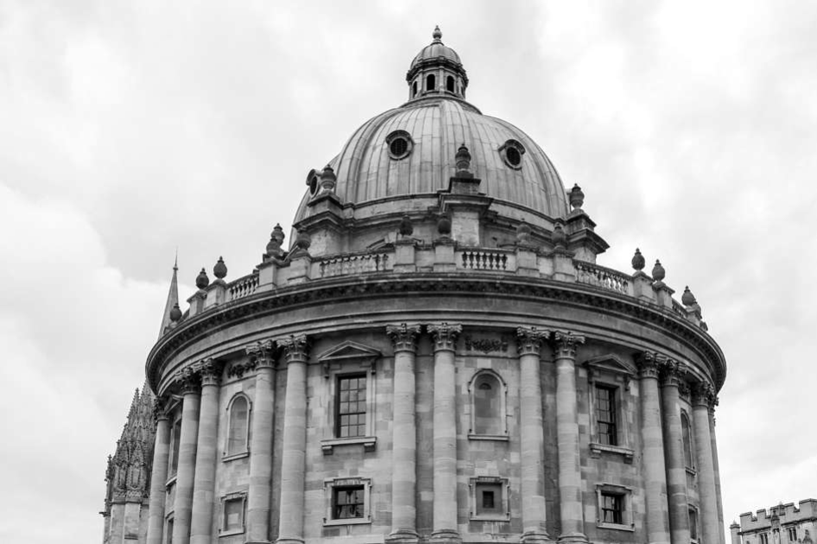
Section A
Exploring the World

Slide 4
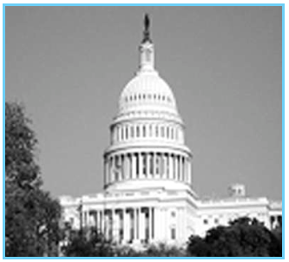
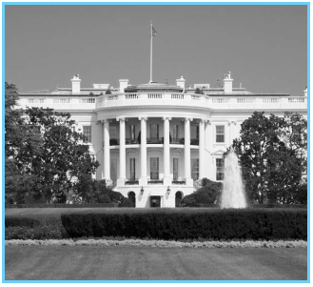
Leading In
1. What do you know about the following pictures?

Slide 5
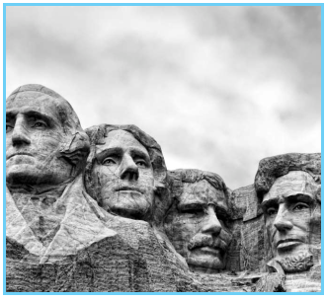
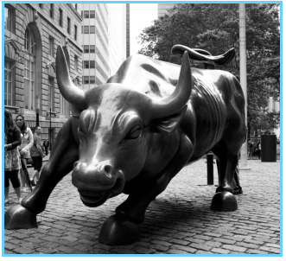
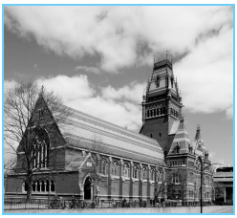

Slide 6
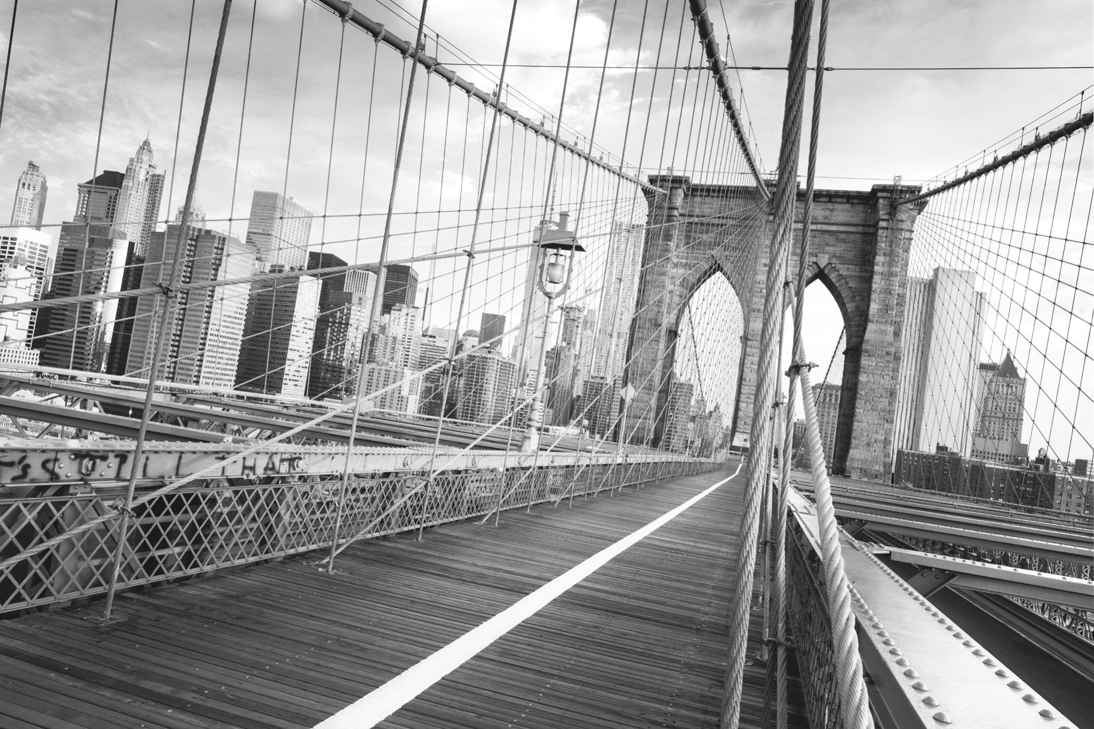
A Brief Introduction to the USA
Geography and Environment
The United States of America (commonly referred to as the United States, the U.S., the USA, or America) is a federal constitutional republic[1] comprising fifty states and a federal district and some overseas territories. The country is situated mostly in central North America, where its forty-eight contiguous states and Washington, D.C., the capital district, lie between the Pacific and Atlantic Oceans, bordered by Canada to the north and Mexico to the south. The state of Alaska is in the northwest of the continent, with Canada to its east and Russia to the west across the Bering Strait. The state of Hawaii is an archipelago in the mid-Pacific. The country also possesses several territories, or insular areas, in the Caribbean and Pacific.

Slide 7
The coastal plain of the Atlantic seaboard gives way further inland to deciduous forests and the rolling hills of the Piedmont. The Appalachian Mountains divide the eastern seaboard from the Great Lakes and the grasslands of the Midwest. The Mississippi-Missouri River, the world’s fourth longest river system, runs mainly north-south through the heart of the country. The flat, fertile prairie of the Great Plains[2], stretches to the west, interrupted by a highland region in the southeast. The Rocky Mountains, at the western edge of the Great Plains, span more than 4,800 kilometers extending north to south in North America. Farther west is the rocky Great Basin and
deserts such as the Mojave. Alaska’s Mount McKinley is the country’s tallest peak. Active volcanoes are common throughout Alaska’s Alexander and Aleutian Islands, and Hawaii consists of volcanic islands. The supervolcano underlying Yellowstone National Park in the Rockies is the continent’slargest volcanic feature.

Slide 8
History
The first known inhabitants of modern-day United States territory are believed to have arrived over a period of several thousand years beginning sometime prior to 15,000 ~ 50,000 years ago by crossing Beringia[3] into Alaska. Solid evidence of these cultures settling in what would become the U.S. is dated to around 14,000 years ago.
Columbus’men were the first who documented Old Worlders[4] to land in the territory of what is now the United States when they arrived in Puerto Rico during their second voyage in 1493. Juan Ponce de León, who arrived in Florida in 1513, is credited as being the first European to land in what is now the continental United States, although some evidence suggests that John Cabot might have reached what is presently New England in 1498.

Slide 9
In its beginnings, the United States of America consisted only of the Thirteen Colonies, which consisted of states occupying the same lands as when they were British colonies. American colonists fought off the British army in the American Revolutionary War[5] of the 1775s and issued the Declaration of Independence in 1776. Seven years later, the signing of the Treaty of Paris officially recognized independence from Britain. In the nineteenth century, westward expansion of the United States territory began, in which the United States would occupy all the North
American land east to west, from the Atlantic to the Pacific Ocean. By 1912, with the admission of Arizona to the Union, the U.S. reached that goal. The outlying states of Alaska and Hawaii were both admitted in 1959.

Slide 10
Ratified in 1788, the Constitution serves as the supreme American law in organizing the government; the Supreme Court[6] is responsible for upholding constitutional law. Many forms of social progress started in the nineteenth century; those advancements have been widely reflected in the Constitution. Slavery was abolished in 1865 by The Thirteenth Amendment to the United States Constitution[7]; the following Fourteenth and Fifteenth Amendments respectively guaranteed citizenship for all the persons naturalized within U.S. territory and voting for people of all races. In later years, civil rights were extended to women and black Americans, following effective lobbying from social activists. The Nineteenth Amendment prohibited gender discrimination in voting rights; later, the Civil Rights Act[8] of 1964 outlawed racial gregation in public places.

Slide 11
The Progressive Era marked a time of economic growth for the United States, advancing to the Roaring Twenties. However, the Wall Street Crash of 1929 led to the Great Depression[9], a time of economic downturn and mass unemployment. Consequently, the U.S. government established the New Deal, a series of reform programs that intended to assist those affected by the Depression. The New Deal had varied success. However, once the U.S. entered World War Ⅱ in December 1941, the economy quickly recovered, so much that the U.S. became a world superpower by the dawn of the Cold War. During the Cold War, the U.S. and the Soviet Union were the world’s two superpowers, but with the end of the Cold War and the collapse of the Soviet Union, the United States became the world’sonly superpower.

Slide 12
Government
What type of government rules the United States?
The United States is a federal constitutional republic. It is the world’s oldest surviving federation. A constitutional republic is a state where the head of state and other officials are elected as representatives of the people, and must govern according to existing constitutional law that limits the government’s power over citizens. The government is regulated by a system of checks and balances defined by the U.S. Constitution, which serves as the country’s supreme legal document. In the American federalist system[10], citizens are usually subject to three levels of government, federal, state, and local; the local government’s duties are commonly split between county and municipal governments. In almost all cases, executive and legislative officials are elected by a plurality vote of citizens by district. There is no proportional representation at the federal level, and it is very rare at lower levels. Federal and state judicial and cabinet officials are typically nominated by the executive branch and approved by the legislature, although some state judges and officials are elected by popular vote. The House of Representatives[11] has 435 members, each representing a congressional district for a two-year term. House seats are apportioned among the states by population every tenth year.

Slide 13
Economy
The United States has a capitalist-mixed economy, which is fueled by abundant natural resources, a well-developed infrastructure, and high productivity. The United States is the largest importer of goods and the third largest exporter, Canada, China, Mexico, Japan, and Germany are its top trading partners. The leading export commodity is electrical machinery, while vehicles constitute the leading import. The United States tops the overall ranking in the Global Competitiveness Report[12]. After an expansion that lasted just over six years, the U.S. economy has been in recession since December 2007.

Slide 14
The leading business field by gross business receipts is wholesale and retail trade; by net income it is finance and insurance. The United States remains an industrial power, with chemical products the leading manufacturing field. The United States is the third largest producer of oil in the world, as well as its largest importer. It is the world’s number one producer of electrical and nuclear energy, as well as liquid natural gas, sulfur, phosphates, and salt. The United States is the world’s top producer of corn and soybeans. The New York Stock Exchange is the world’s largest
by dollar volume. Coca-Cola and McDonald’s are the two most recognized American brands in the world. Wall Street is home to the New York Stock Exchange.

Slide 16
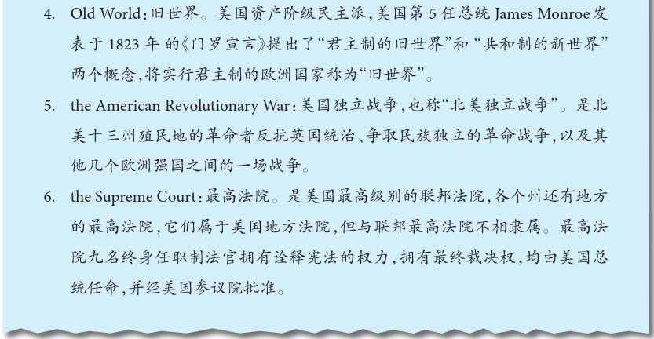

Slide 19
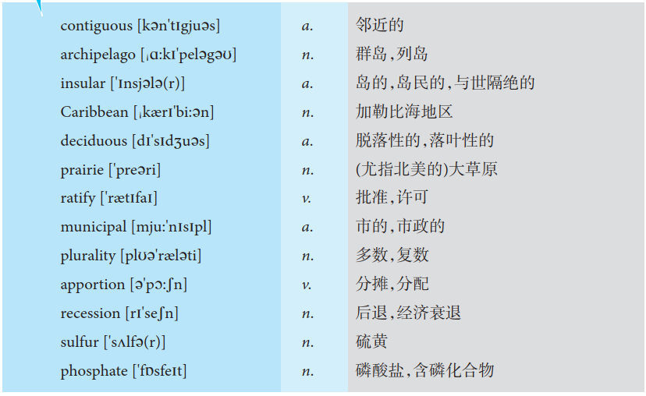
Vocabulary

Slide 20
Lesson Review
Task 1 Match each statement with the proper word.
1. contiguous
2. archipelago
3. insular
4. Caribbean
5. deciduous
6. prairie
7. ratify
8. municipal
9. plurality
10. apportion
11. recession
12. sulfur
13. phosphate
A. a treeless grassy plain
B. (plants and shrubs) shedding foliage at the end of the growing season
C. to approve and express assent, responsibility, or obligation
D. very close or connected in space or time
E. a salt of phosphoric acid
F. a pale-yellow, nonmetallic chemical element found in crystalline or amorphous form
G. a group of islands
H. of or relating to a town, city, or borough or its local government
I. the state of the economy declines
J. to distribute according to a plan
K. a large indefinite number
L. an arm of the Atlantic Ocean between North and South America
M. remote, detached, or aloof

Slide 21
Task 2 Choose one exclusively from the following options for each sentence.
contiguous deciduous prairie ratify apportion recession
prairie
1. Flames and smoke billowed over the ( ).
2. It was difficult to ( ) the blame for the accident.
3. ( ) trees shed their leaves in autumn.
4. The agreement has to be ( ) by the board.
5. Whenever ( ) strikes, a chain reaction is set into motion.
6. Viet Nam is ( ) to China.
apportion
deciduous
ratified
recession
contiguous

Slide 22
Task 3 Fill in the blanks according to the text.
1. In the American federalist system, citizens are usually subject to three levels of government, ______, ______ and _______.
2. The state of _________ is in the northwest of the continent, with Canada to its east and Russia to the west across the _____________________.
3. The local government’s duties are commonly split between __________ and __________ governments.
federal
state
local
Alaska
Bering Strait
country
municipal

Slide 23
Task 3 Fill in the blanks according to the text.
4. The ____________ Mountains divide the eastern seaboard from the Great Lakes and the grasslands of the Midwest.
5. Juan Ponce de León, who arrived in Florida in 1513, is credited as being the ______ European to land in what is now the continental United States, although some evidence suggests that John Cabot might have reached what is presently _______________ in 1498.
Appalachian
First
New England

Slide 24
Task 4 Fill in the following table.
Cities | States | Main Characteristics
 |  | self-proclaimed“the capital of the world”
Las Vegas |  | “sin city”
 | Massachusetts | retained more of its original buildings as memorials to America’spast
Chicago | Illinois
 |  | The Golden Gate Bridge
Madeira Beach
Florida
California
Boston
Memorials to America’s past Wealth of diverse foods
San Francisco
California

Slide 25
The American Culture
The United States is a multicultural nation, home to a wide variety of ethnic groups, traditions, and values. Aside from the now small Native American and Native Hawaiian populations, nearly all Americans or their ancestors immigrated within the past five centuries. The culture held in common by most Americans — mainstream American culture — is a Western culture largely derived from the traditions of European immigrants with influences from many other sources, such as traditions brought by slaves from Africa. More recent immigration from Asia and especially Latin America has added to a cultural mix that has been described as both a homogenizing melting pot and a heterogeneous salad bowl in which immigrants and their descendants retain distinctive cultural characteristics.

Slide 26
American Individualism Score
According to Geert Hofstede’s[1] cultural dimension analysis, the United States has the highest individualism score of all the countries studied. While the mainstream culture holds that the United States is a classless society, scholars identify significant differences between the country’s social classes, affecting socialization, language, and values. The American middle and professional class has initiated many contemporary social trends such as modern feminism, environmentalism, and multiculturalism. Americans’self-images, social viewpoints, and cultural expectations are associated with their occupations to an unusually close degree. While Americans tend greatly to value socioeconomic achievement, being ordinary or average is generally seen as a positive attribute. Though the American Dream, or the perception that Americans enjoy high social mobility, plays a key role in attracting immigrants, some analysts find that the United States has less social mobility than Western Europe and Canada.

Slide 27
The United States, like other countries, has rich and poor people and rich and poor neighborhoods.
For every person who is successful, they are usually better educated than their parents and therefore more likely to have good, well-paying jobs.
In addition to the fact that the United States includes people whose families originally came from many other parts of the world, Americans move across the nation in great numbers. The continuous mixing of people into new communities is an important observation to consider when we are trying to understand the meaning of class in America.“Do- it- yourself”American personality is another important consideration.

Slide 28
A Man’s Social Class
In many countries, a man’s social class is determined at birth. That is, his social class or position is shared with his family, his wider group of relatives. In the United States, position in society is, to a large degree, personal rather than related to family or group.

Slide 29
Before World War Ⅱ [2], family ties were more important in America than they are now. Uncles, aunts, grandparents, and children vacationed together, spent holidays together, and saw much of each other. But as the American economy developed more rapidly after the war, social customs began to change. With the rapidly growing economy, there were new employment opportunities, and many of them were in scientific fields. These opportunities were often located in other parts of the country. The younger members of many families who were well educated
began to move away from the towns where their families lived to take these new jobs. As these young people became successful, they often moved into a new social stratum, consisting of others who, like themselves, moved away from home to follow job opportunities.

Slide 30
These same changes are already happening in most new countries around the world. Today, a man who can read or fix a machine may become the new leader of his community in place of old men. Often young people can better understand the new sciences and modern skills; as these young people learn and advance, their wages rise and they become increasingly successful.
Frequently, it is just one member of a family that becomes very successful. Other members continue working at their average jobs and salaries, without much chance of becoming as successful as the son or daughter. When this happens, people sometimes become separated from their family. Many return to visit their relatives and old friends, but others move away and never return.

Slide 31
To many people, success means having more power than one possessed before. It can be won through skills, knowledge, leadership, or sometimes just by hard work. In America,“success”has normally been accompanied by an increase in wealth. As a result, an individual’s social position is determined not by a person’sjob but by the kinds of possessions he owns.
The development of the culture of the United States of America — History, Holidays, Sports, Religion, Cuisine, Literature, Poetry, Music, Dance, Visual Arts, Cinema, and Architecture — has been marked by a tension between two strong sources of inspiration: European ideals, especially British, and domestic originality.

Slide 32
American culture encompasses traditions, ideals, customs, beliefs, values, arts, and innovations developed both domestically and imported via colonization and immigration. Prevalent ideas and ideals from the European continent such as Democracy, Christianity, and Civil Liberties are present as well as those which evolved domestically such as important National holidays, uniquely American sports, proud military tradition, innovations in the arts and entertainment, and a strong sense of national pride among the population as a whole. It includes both conservative elements and liberal elements, military and scientific competitiveness, political structures, risk taking and free expression, materialist and moral elements. It also includes elements which evolved from Native Americans, and other ethnic subcultures, most prominently African-American and Latin American culture. Many cultural elements, especially popular culture, have been exported across the globe through modern mass media, but a few of the cultural elements have remained rather exclusive to North America.

Slide 34
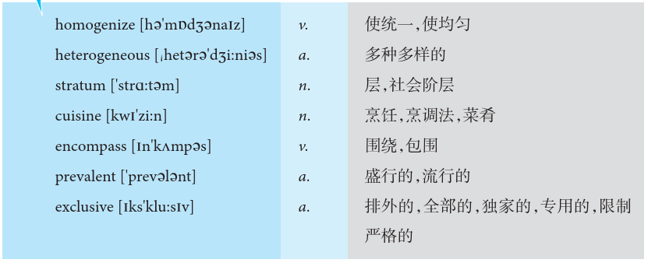
Vocabulary

Slide 35
Lesson Review
Task 1 Match each statement with the proper word.
1. homogenize
2.heterogeneous
3. stratum
4. cuisine
5. encompass
6. prevalent
7. exclusive
A. a class in a society
B. not divided or shared with others
C. widespread at present time
D. the practice or manner of preparing food
E. cause to become equal or similar as by mixing
F. consisting of elements that are not of the same kind or nature
G. to enclose within a circle; surround

Slide 36
Task 2 Please fill in the blanks with the appropriate words from the text.
1. The development of the culture of the United States of America — History, Holidays, Sports, Religion, Cuisine, Literature, Poetry, Music, Dance, Visual Arts, Cinema, and Architecture — has been marked by a tension between two strong sources of inspiration: _______________, especially British, and ____________ originality.
2. American culture encompasses traditions, ideals, customs, beliefs, values, arts, and innovations developed both domestically and imported via ___________ and __________. Prevalent ideas and ideals from the European continent such as _________, ___________, and __________ are present as well as those which evolved domestically.
3. According to Geert Hofstede, the United States has the highest ____________ score of all the countries studied.
European ideals
domestic
colonization
immigration
democracy
Christianity
Civil Liberties
Individualism

Slide 37
Task 3 Oral Presentation
• How do you understand American selfishness?
• How do the young Americans judge“success”and what are their ways of achieving it?
The most common sentence that many US people say when they see Chinese people is that you are a successful person. Why do they say that? Because they can live in their own house, drive a fancy car, and have a good job. This is perhaps the main sign that many young Americans judge “success”.

Slide 38
Section B
Broadening My Horizon

Slide 39
Access to Education in the United States
American Public Education
American public education is operated by state and local governments, regulated by the United States Department of Education through restrictions on federal grants. Children are re- quired in most states to attend school from the age of six or seven (generally, kindergarten or first grade) until they turn eighteen (generally bringing them through the twelfth grade, the end of high school); some states allow students to leave school at sixteen or seventeen. About 12% of children are enrolled in parochial or nonsectarian private schools. The United States has many competitive private and public institutions of higher education, as well as local community colleg- es with open admission policies.

Slide 40
American Vocational Education
In the United States, vocational education varies from state to state. Roughly 70 percent of all postsecondary technical and vocational training is provided by proprietary (privately owned) career schools. The remaining 30 percent is provided primarily by two-year community colleges, which also offer courses transferable to four-year universities, military technical training, and government-operated adult education centers. Several states operate their own institutes of tech- nology which are on an equal accredited footing with other state universities.

Slide 41
Historically, junior high schools and high schools have offered vocational courses such as home economics, wood and metal shop, typing, business courses, drafting and auto repair, though schools have put more emphasis on academics for all students because of standard-based education reform. School to Work is a series of federal and state initiatives to link academics to work, sometimes including spending time during the day on a job site without pay.

Slide 42
Federal involvement is principally carried out through the Carl D. Perkins Career and Techni- cal Education Act[1]. Requirements tied to the receipt of federal funds under this Act help to pro- vide some overall leadership. The Office of Vocational and Adult Education within the U.S. De- partment of Education also supervises activities funded by the Act. The Association for Career and Technical Education (ACTE) is the largest private association dedicated to the advancement of education that prepares youth and adults for careers.

Slide 43
Potential foreign students, as well as all aliens, must satisfy Department of State (DOS) con- sular officers abroad and immigration inspectors upon entry to the United States that they are not ineligible for visas under the so-called“grounds for inadmissibility”of The Immigration and Nationality Act[2], which includes security and terrorist concerns. The consular officers who pro- cess visa applicants are required to check the consolidated Terrorist Screening Database (TSDB) before issuing any visa. In part because of these security measures, student visa debates have ex- panded to include both security and market-based discussions. Higher education institutions in the United States are concerned over their ability to attract the numbers and quality of foreign stu- dents, and whether the post September 11 security measures impede the entry of potential stu- dents into the U.S. education system. The fields of science, technology, engineering and mathe- matics (STEM) [3] increasingly rely on foreign students, and these fields hold a top priority with most research institutions. Furthermore, the U.S. economy has a high demand for the skill-sets produced in these fields of study, and the STEM students often provide a major link between the academic community and the labor market. Consequently, many groups in higher education and the private sector are seeking to expand

Slide 44
pathways for foreign students to emigrate to the United States. All nonimmigrant students are issued visas from one of three categories, and are moni- tored and tracked by the Department of Homeland Security (DHS). The three visa categories used by foreign students are F visas for academic study, M visas for vocational study, and J visas for cultural exchange. The numbers admitted have more than doubled over the past two decades. The Student and Exchange Visitor Information System (SEVIS) aims to manage the tracking and monitoring of foreign students. Participation in the SEVIS program is now mandatory for all higher education institutions enrolling foreign students. A diverse set of issues related to foreign students, including foreign student funding and English-language competency, has raised concerns with some universities, advocacy groups, and other observers. Additionally, some recent legisla- tion has focused on attracting foreign students in STEM fields. Legislation introduced in the House (H.R. 1645) and in the Senate (S. 1639) would create pathways to legal permanent resi- dence for foreign students in the STEM fields of study. Although there are provisions in this legis- lation for undergraduate students, the emphasis has been on students obtaining advanced de- grees.

Slide 47
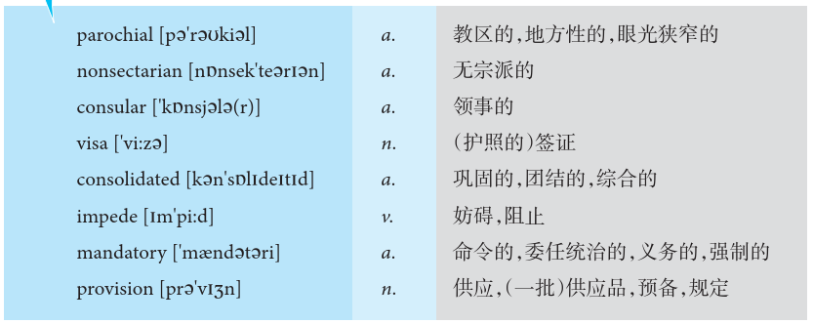
Vocabulary

Slide 48
Lesson Review
Task 1 Match each statement with the proper word.
1. parochial
2. nonsectarian
3. consular
4. visa
5. consolidated
6. impede
7. mandatory
8. provision
A. an endorsement made in a passport that allows the bearer to enter the country issuing it
B. be a hindrance or an obstacle to
C. relating to or supported by or located in a parish
D. having to do with a consul or his/her office or duties
E. joined together into a whole
F. obligatory; compulsory
G. the activity of supplying or providing something
H. not confined to or affiliated with any specific religion

Slide 49
Task 2 Choose one exclusively from the two options for each sentence.
1. Officials tend to tilt toward secrecy from a globalization/parochial view of their responsibilities.
2. Those two banks have consolidated/connected and formed a single large bank.
3. It is elected/mandatory for blood banks to test all donated blood for the virus.
1. parochial 2.consolidated 3.mandatory

Slide 50
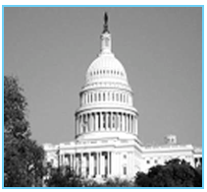
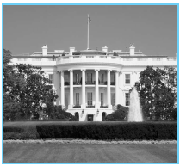
Travel to America
Do you know the places in the following pictures? Is any of them your favorite
destination? If there is none, please introduce your favourite.

Slide 51
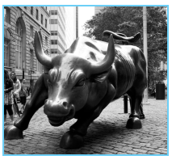
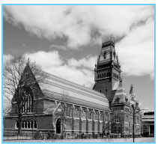

Slide 52
What should you know when you are going to the United States?
After arriving in America, your documents will be checked by the customs officer. You must fill in a customs declaration form and show your inoculation certificate and passport. Having received your baggage, you should hand in your customs declaration form and luggage check.
According to“American Customs Hints for Visitors (Non-Residents)”,foreigners coming to America can bring the following articles free of charge：
1. Personal Belongings—goods used by oneself, not to be sold. This includes clothing, jewelry, electrical equipment and sports equipment.
2. Household Utensils—furniture, carpets, and equipment for work. But they are supposed to be for personal use only and are not to be sold.

Slide 53
3. Gifts—Entering the U.S., you can bring $ 100 worth of presents, but you have to stay in the United States for at least 72 hours. Moreover, in the past six months, you shouldn’tbring any of the same gifts into the country.
4. Cigarettes and Alcohol—Adults may bring 0.95 kl of wine, 300 cigarettes, and 1.35 kg of tobacco.
How do you transfer in America?
After arriving in America, if you need to make a transfer, you can choose to take a domestic American airline. American aviation is highly developed, including American Airlines, United Airlines, Delta Airlines, Southwest Airlines, JetBlue, Alaska Airlines, Hawaiian Airlines, Frontier Airlines, Spirit Airlines, Virgin America, etc..

Slide 54
Transportation in the Cities
Having arrived at your destination, you should make your way to the city. Normally, an airport is very far from a city, so you may take a shuttle bus that runs every half hour. The transportation is very convenient, but the shuttle bus will not send you to the exact place where you want to go.
You can also take a taxi. There are two kinds of taxis in America：the yellow cab and the checker cab. The former has four seats, while the latter has five. A taxi charges according to the distance. However, in Washington D.C., it charges by the zone system. In addition to the distance fee, you have to pay for toll, and 15 percent tip.

Slide 55
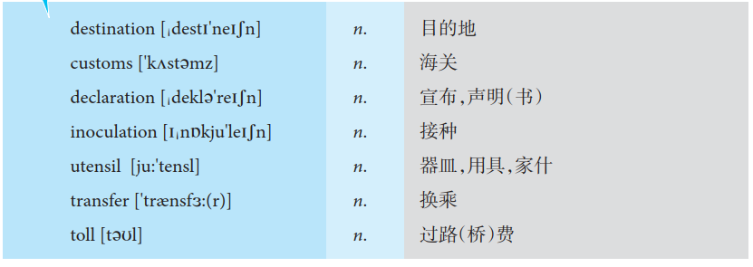
Vocabulary

Slide 56
Lesson Review
Task 1 Match each statement with the proper word.
1. destination
2. customs
3. declaration
4. inoculation
5. utensil
6. transfer
7. toll
A. a statement of taxable goods or of dutiable properties
B. a fee levied for the use of roads or bridges (used for maintenance)
C. the tool or object that you use in order to help you to cook or to do other tasks in your home
D. the place designated as the end of a race or journey
E. the official organization responsible for collecting taxes on goods
coming into the country and preventing illegal goods from being brought in
F. the act of transporting something from one location to another
G. taking a vaccine as a precaution against contracting a disease

Slide 57
Task 2 Oral Presentation
Describe a foreign country you want to go and want to know more about.
You should say:
• what country it is;
• what you want to know more about it;
• why you want to know more about it.

Slide 58
Sample answer：
The country that I have always wanted to go but have not visited yet is Canada. I’ve been dreaming to visit there for more than 2-3 years. Canada has lots of picturesque landscapes and it also has a varied culture.
Canada boasts that it is one of the most beautiful countries in the world. For example, Vancouver is located right on the ocean, and there are enormous snow-tipped mountains surrounding the entire city. There are a multitude of beautiful parks to walk through, and very nice beaches. Besides, all across the country there are small, picturesque towns located on mountains and valleys. In general, Canada is an incredibly clean country, which also helps its beauty.

Slide 59
Another reason I want to go there is to attend one of the universities there for my bachelor’s degree. I think that it would be an excellent idea to go see the school, and perhaps even meet some of the professors that teach the courses I am interested in. It would also be beneficial for me to meet other students.

Slide 60
Section C
Reading for Pleasure

Slide 61
American Food Habit
1. Please list some famous American food.
2. What is the most popular food in America?
3. What do you think are the significant differences between China and America concerning eating?

Slide 62
In general，American food is mild tasting；most Americans do not season their food to any great degree. Salads are very popular and are served all year round，especially in summer. Waiters tend to assume that everyone drinks coffee，but simply tell them if you wish something else. If a waiter says“Now or later？”,he means“Do you want coffee with your meal or after it？” Many，but certainly not all，Americans drink coffee or tea with their meals. Either way is perfectly acceptable. When dining out，you can ask for tea，milk，“coke”，wine or beer if you prefer. Restaurants can only serve beer，wine，or other alcoholic drinks if they have a license， that is，permission from the local government to serve alcoholic drinks. Normally，when eating in a private home，it is considered better manners to take whatever is being served and not to ask for something different, unless the hostess gives you a choice.

Slide 63
The main course served in American meals is usually meat, fish, or poultry, but rarely is more than one of these served at the same meal. Seafood is sometimes served as the first course, however. Most Americans eat breakfast and lunch quickly unless it is a social, business, or family occasion. The evening meal, however, is usually longer and a time for the family to get together. Rushing through daytime meals is part of the fast pace in America. Another reason for rushing through daytime meals is that many people eat breakfast and lunch in restaurants that are usually crowded with people waiting for a place so that they, too, can be served and return to work at the proper time. So each one hurries to make room for the next person. As with busy people everywhere there is a real difference between a meal that is eaten in a hurry and one that can be enjoyed with friends during one’sleisure.

Slide 64
Two of the most popular American foods are hot dogs and hamburgers. You will find these available at almost all“fast food”restaurants. Hot dogs are also called“franks”,a short form for frankfurters. A hot dog is usually made either from beef or pork, or a combination of the two, but a hamburger is beef. Both are served on a bread roll: hot dogs on a long roll and hamburgers on a round roll. You have your choice of adding a number of sauces and vegetables at no extra charge. A favorite sauce of many Americans is a tomato sauce called ketchup or catsup*.

Slide 65
When you are ordering your lunch at a“fast-food”place, do not be surprised if you do not understand the food orders — neither do many Americans. For example,“draw one”, means “pour a cup of coffee”；BLT means bacon, lettuce and tomato sandwich. No one expects you to know this special vocabulary. Order your meal in the usual way. Eating places use their own special words to place an order quickly.
American eating is funny. They eat almost everything with a fork, and it appears that holding a knife in one’s right hand longer than a few seconds is considered to be against good table manners.

Slide 66
The system is that if it is absolutely necessary to use a knife, a person takes the fork in his/her left hand, and cuts off a piece of meat or whatever it is in the normal manner. Then he/she puts the knife down, transfer the fork to his/her right hand, and only then does he/she transport the food to his/her mouth. This is clearly ludicrous, but it is considered good manners.
Some Words and Phrases About Food
1. meat and two veg：meat, potatoes and another vegetable;
2. vegans：people who eat no meat or animal products;
3. convenience/prepared foods：prepared meals that need only to be heated;
4. takeaways from Indian or Chinese restaurants are also popular;
5. order in：have a meal delivered to one’shome by a restaurant;

Slide 67
6. burger bars, pizzerias, fast-food outlets;
7. healthy eating, healthy foods;
8. fry-up：fried bacon, sausage and an egg with fried bread;
9. organic produce：cereals and vegetables grown without the use of chemicals;
10. a scrambled egg, a boiled egg, a fried egg,“sunny-side up”“over”“over-easy/easy-over”
11. have your ice-cream in a“plain cone”or in a“sugar cone”.

Slide 68
Table Manners
1. Don’t put your own utensils into a serving bowl. Use the utensil in the bowl to put some of the food on your own plate, and then return the serving utensil to the bowl.
2. Don’t spit food anywhere. If you have bones in your mouth, take them out with your fingers and place them on the edge of your plate, never on the table or on the floor.
3. Don’t drink soup out of the bowl. Use a spoon.
4. Don’t reach across the table or in front of another person. Ask someone to pass whatever you want.

Slide 69
5. Don’t put net shells or fruit peeling on the floor. Put them in a plate or an ash tray, or on the table.
6. Don’t belch out loud. If you do, you must say：“Excuse me”quietly and go on with the conversation.
7. Don’t sneeze or blow your nose anywhere except into a handkerchief or a Kleenex. If you cough, cover your mouth with your hand.

Slide 71
Vocabulary

Slide 72
Lesson Review
Task 1 Match each statement with the proper word.
1. sunny-side up
2. over-easy
3. plain cone
4. sugar cone
5. Kleenex
A. soft tissue paper used as a handkerchief, etc.
B. eggs fried on one side only
C. eggs cooked on both sides
D. a shape whose base is a circle and whose sides taper up to a point
E. a crisp sweet conical wafer

Slide 73
Task 2 Oral Presentation
Describe a kind of food that people eat during special events.
You should say:
• what it is;
• what event people usually eat it / why people eat it;
• how it was cooked;
• how you feel about this kind of food.
If I have ten-day to travel to UK, I plan to fly to London Heathrow Airport and then visit the British Museum first……..

Slide 74
Sample answer：
The Lantern Festival or the Spring Lantern Festival is a Chinese festival celebrated on the fifteenth day of the first month in the lunar calendar. It marks the final day of the traditional Chinese new year celebrations, traditionally we would eat glutinous rice balls, which are a popular Chinese dessert made from glutinous rice flour mixed with a small amount of water to form balls and either cooked and served in boiling water with fermented glutinous rice or deep fried.
Tangyuan can be either small or large, unfilled or filled with red beans, sesame, peanut, and other sweet fillings that ooze out from the mochi-like dumpling skins. The dumpling skins owe their pleasantly gummy texture to glutinous rice flour that produces chewy dough. Unlike in ancient times, these glutinous rice balls can be easily grabbed at any time point and everywhere these days. But, I’ve always believed that life should have some sense of ritual, and to eat glutinous rice ball symbolizes family reunion.

Slide 75
Chapter Revision
Task 1 Do the following statements agree with the information given in Reading?
TURE(T) if the statement agrees with the information
FALSE(F) if the statement contradicts with the information
( ) 1. The United States stretches from the Atlantic Ocean in the west to the Pacific Ocean in the east.
( ) 2. The Mississippi river is the longest river in the United States.
( ) 3. Washington D. C. is located in the Southern States Region.
( ) 4. The first English colony in America was founded at Jamestown, Virginia, in 1607.
( ) 5. The early British settlers organized the east coast of North America into 17 colonies.
F
T
F
T
F

Slide 76
Task 2 Choose the best one of the four choices for each sentence.
1. The United States of America is the ____________ country in the world in size.
A. Largest B. second-largest C. third-largest D. fourth-largest
2. ____________ extend from the northern tip of Maine southwestern to Alabama.
A. The Rocky Mountains B. The Appalachian Highlands
C. The Coast Mountains D. The Blue Mountains
3. The climate of the United States is influenced by ____________.
A. the Atlantic and Pacific Oceans B. the Gulf of Mexico
C. the Great Lakes D. all of the above

Slide 77
Task 2 Choose the best one of the four choices for each sentence.
4. What is the leading commercial crop of the south?
A. Cotton. B. Tobacco. C. Sugar cane. D. Rice.
5. New England lies in __________ of the United States.
A. the northern part B. the southern part
C. the northeastern part D. the southeastern part
6. The southern part of the Pacific coast in California has a ___________ climate.
A. subtropical B. continental desert C. maritime D. Mediterranean

Slide 78
Task 2 Choose the best one of the four choices for each sentence.
7. The serious economic crisis in the late 1920s and 1930s was first brought about by _____________.
A. bank failures B. serious unemployment
C. farm foreclosures D. the stock market crash
8. The first immigrants in American history came from __________.
A. England and the Netherlands B. Ireland
C. West Germany D. East Europe
9. The Native Americans are __________.
A. the Indians B. the whites C. the blacks D. the Hispanics

Slide 79
Task 2 Choose the best one of the four choices for each sentence.
10. American schools fall into two categories, namely, _______________.
A. public and private schools B. academic and vocational schools
C. coeducation and single sex schools D. national and state-run schools

Slide 80
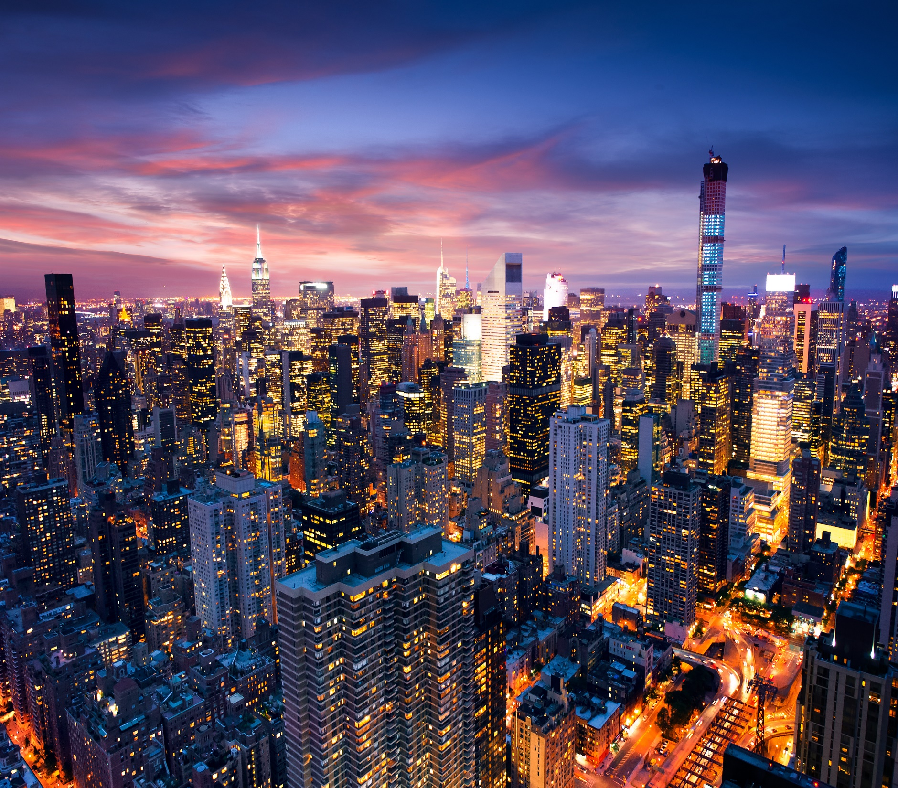
Thank you

