Slide 1
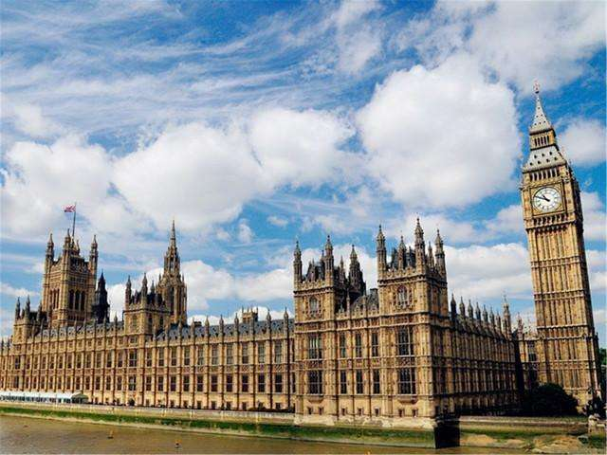
英语国家社会与文化
The Society and Culture of English-Speaking Countries
主 编：杨筱霞

Slide 2
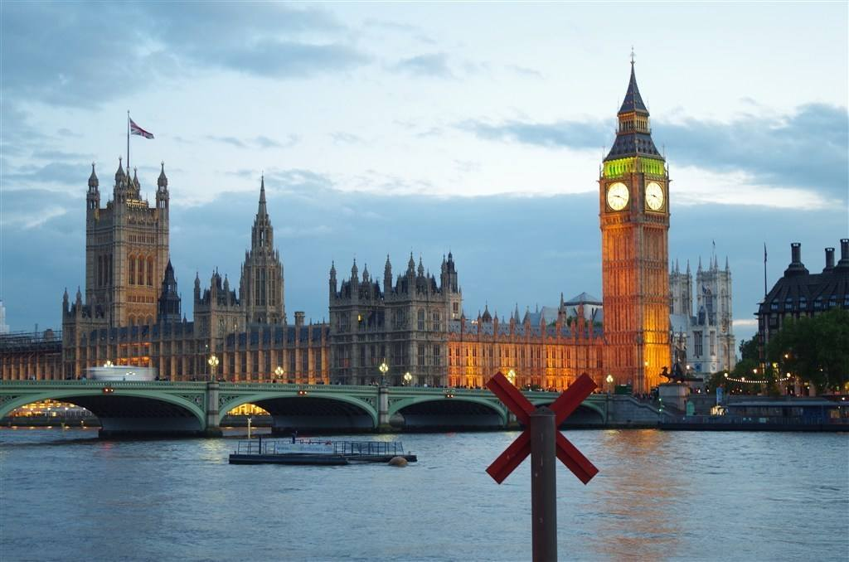
4
Chapter
Australia
Learning Objectives
• Master the key facts of Australia.
• To understand the climate, history, population, belief, politics, economy, education and
customs of Australia.
• Make an oral report about the sports and the places mentioned in the texts.

Slide 3
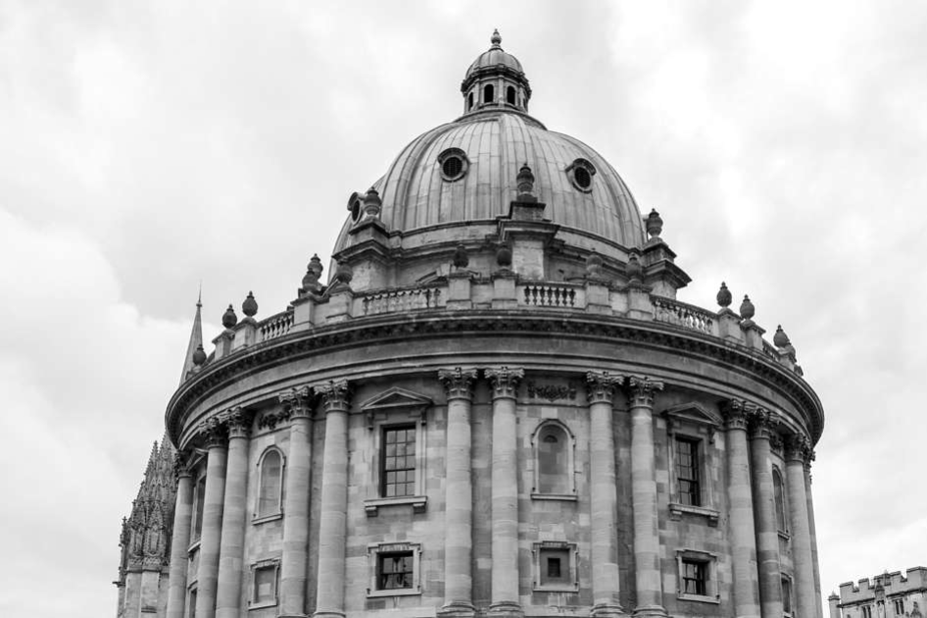
Section A
Exploring the World

Slide 4
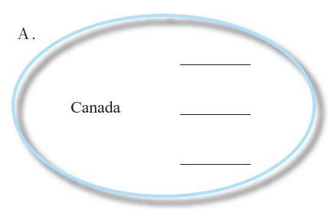
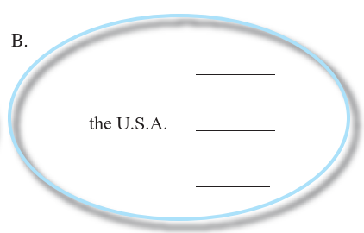
Leading In
Please pick out proper words from the following box and put them into the corresponding places.
Hockey, Rockies, Maple Leaf
Uncle Sam, the Great Seal, Statue of Liberty

Slide 5
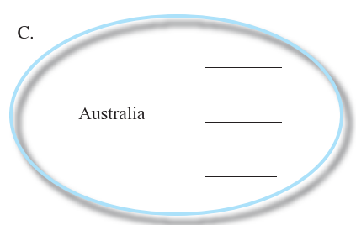
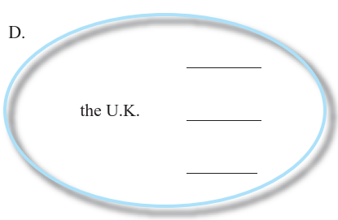
Leading In
Kangaroo, Ayer’s Rock, Koala
Tower of London, Union Jack, Buckingham Palace

Slide 6
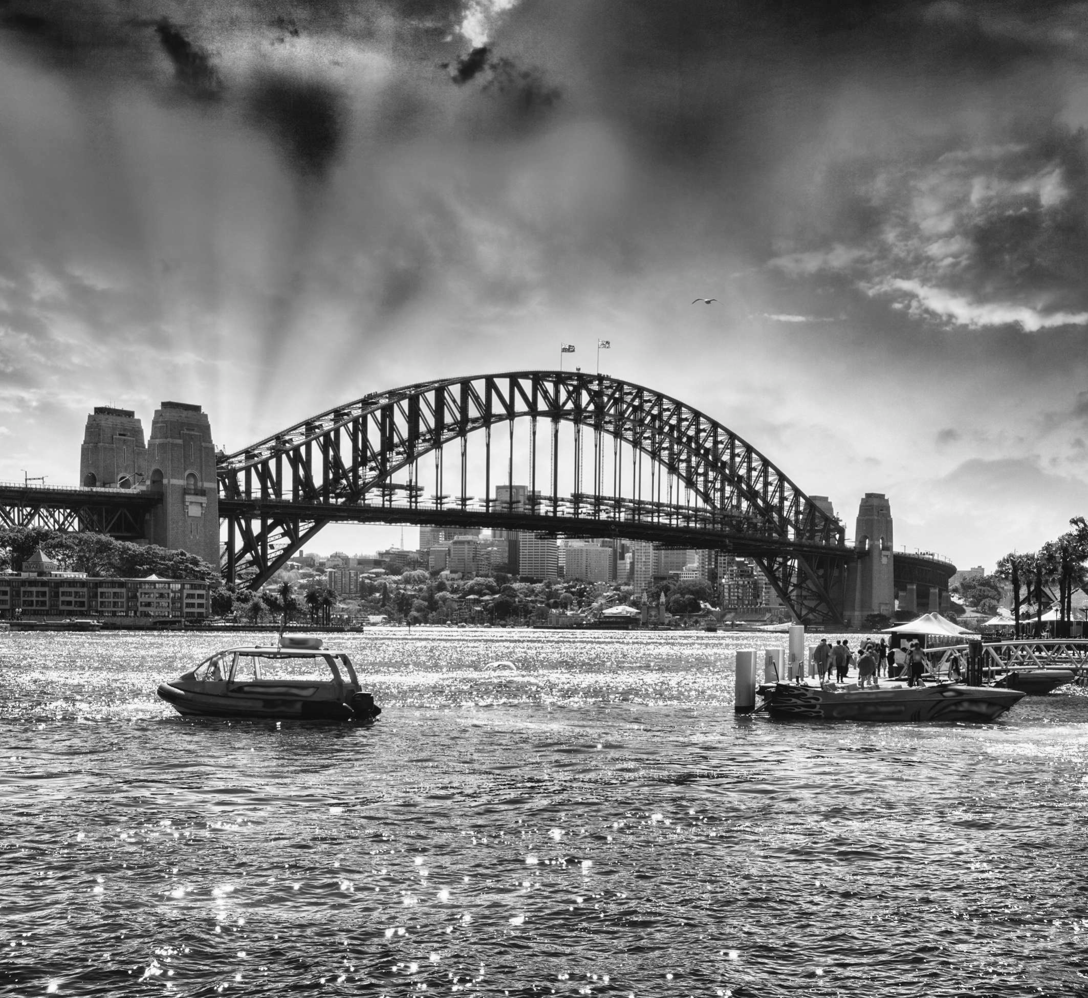
A Brief Introduction to Australia
Australia is a continent between the Indian Ocean and the South Pacific Ocean. The Commonwealth of Australia[1] is made up of six states and two major mainland territories. There are also lesser territories that are under the administration of the federal government.
Climate: Australia has a climate that widely varies among the different regions within the country. Generally it is arid to semiarid, temperate in south and east, tropical in north. The pattern of rainfall is also distinct — some places have abundant rain at one time of the year and almost none at other times.

Slide 7
The wet season lasts about six months in summer and spring, between December and March. It is hotter than the dry season, with temperatures between 30 and 50 degrees Celsius. This is because of the high humidity during the wet, which is caused by large amounts of water in the air. During the wet there is a lot of rain, which frequently causes flooding.
The dry season lasts about six months in autumn and winter, usually between May and October. Temperatures are lower and the skies are generally clearer during the dry. The average temperature is around 20 degrees Celsius.

Slide 8
History: The written history of Australia began when Dutch explorers first sighted the landmass in the 17th century. In command of the ship Duyfken, Willem Jansz，Dutch，sailed along the southern coast of New Guinea before he turned south and sighted Cape York Peninsula on Australia’s northern coast. Jansz named the land New Holland and explored the Gulf of Carpentaria on the cape’s western shore. The western coast was first visited in 1616 by the Dutch, Dirk Hartog. The first recorded European sighting of the South Australian coast was in 1627 when the Dutch ship the Gulden Zeepaert, captained by Francois Thijssen, examined the coastline.

Slide 9
The history of Australia from 1788 to 1850 covers the early colony period, from the first British settlement and penal colony[2] at Port Jackson[3] in 1788 to the establishment of other colonies and the spread of settlers. The history of Australia from 1851 to 1900 was also part of Australia’s colonial history, including the discovery of gold[4] in 1851 which led to increased economic and political independence from Britain, and a great debate about federation. The history of Australia from 1901 to 1945 began with the federation of the colonies to create the Commonwealth of Australia. The history of Australia since 1945 has seen a move-away from Britain[5] in political, social and cultural terms to engagement with the United States and Asia.

Slide 10
Population: Population of Australia owing to its historical developments and governmental policies consists of people of different races, religions and countries. Overseas migration played an important role in changing Australia’s population.
Belief: Among the population of Australia, Christianity is the religion of the majority.
Politics: The Politics of Australia take place within the framework of parliamentary democracy[6]. Australia is a federation and a constitutional monarchy, and Australians elect state and territory legislatures based on the Westminster tradition. In the states and territories, elections are held at least once every four years.

Slide 11
Economy: The economy of Australia is a prosperous, free market economy dominated by its service sector (68% of GDP), although the agricultural and mining sectors (10% of GDP combined) account for 57% of the nation’s exports.
The service sector — or tertiary economy — includes: banking, insurance and finance; the media and entertainment industries; consulting, tourism and retail; services provided by government, such as education, health and welfare; and other personal and business services.

Slide 12
Australia is a major agricultural producer and exporter. There is a mix of irrigation and dry-land farming. There are 3 main zones: high rainfall zone (generally coastal) (used for dairying, prime lamb, beef and wool production), wheat sheep zone (cropping, principally winter crops), and the grazing of sheep (for wool, lamb and mutton and beef cattle) and the pastoral zone (characterized by low rainfall, less fertile soils, and large area farming activities involving the grazing of beef cattle and sheep for wool and mutton).
Mining is a significant primary industry and contributor to the economy of Australia and encourages immigration to Australia. Many different ores and minerals are mined throughout the country.

Slide 14
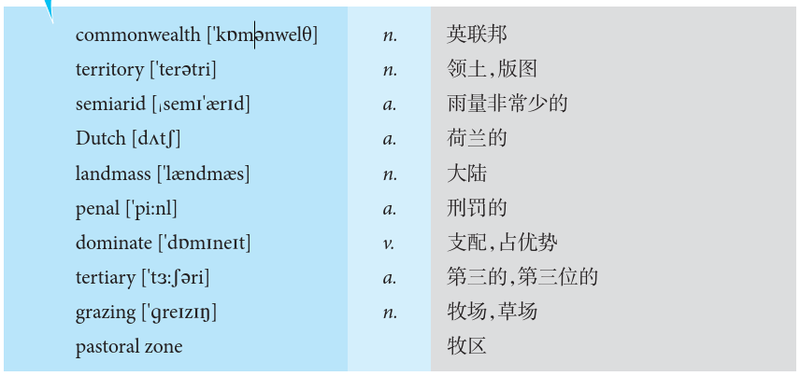
Vocabulary Power

Slide 15
Lesson Review
Task 1 Match each statement with the proper word.
1. territory
2. semiarid
3. Dutch
4. landmass
5. penal
6. commonwealth
7. dominate
8. tertiary
9. grazing
10. pastoral zone
A. an organization consisting of the United Kingdom and most of the countries that were previously under its rule
B. an area relating to the farming or gazing of sheep or cattle
C. the vegetation on pastures that is available for livestock to feed upon
D. be larger in number, quantity, power, status or importance
E. of or relating to the Netherlands or its people or culture
F. of or relating to punishment
G. coming next after the second and just before the fourth in position
H. a large continuous extent of land
I. a region marked off for administrative or other purposes
J. characterized by scanty rainfall and scrubby vegetation, often occurring in continental interiors

Slide 16
Task 2 Choose one of the following options for each sentence.
1. There we saw herds of cows ( ) on the pasture.
2. Israel captured the ( ) in the 1967 War.
3. The strong usually ( ) over the weak.
grazing
territory
dominate

Slide 17
Task 3 Please fill in the following blanks with the suitable words from Text A.
1. The Commonwealth of Australia is made up of ________ states and _______ major main- land territories.
2. The written history of Australia began when ______ explorers first sighted the landmass in the ______ century.
3. The wet season lasts about six months in summer and spring, between ____________ and March; the dry season lasts about six months in autumn and winter, usually between _____ and October.
six
two
Dutch
17th
December
May

Slide 18
Task 3 Please fill in the following blanks with the suitable words from Text A.
4. The service sector includes: __________, insurance and finance; the media and entertain-ment industries; ___________, tourism and __________; services provided by government, such as education, health and ___________; and other personal and business services.
5. There are 3 main agricultural zones: ____________ zone, _________________ zone and __________ zone.
banking
consulting
retail
welfare
high rainfall
wheat sheep
pastoral

Slide 19
Cultural Tips in Communication
Look at these mouth-watering foods. Have you been tempted?
Barbecues are a big part of Australian culture. If invited to a barbecue in Australia, you’ll find that they’re a fun and popular social gathering. In Australia, people will typically bring their own beer or wine for their own consumption, or at very informal barbecues, you may even be asked to bring your own meat for the grill.
So, as the old commercial said,“Slip an extra shrimp on the Barbie!”and learn a bit about Australian etiquette, including barbecue etiquette. Below you’ll find a list of some typical Australian etiquette for your trip.

Slide 20
1. What to Wear
DO wear casual clothing if you’re not going to a business function.
DO wear the following attire for business functions: a dark business suit and tie for a man or a skirt and blouse or a dress if you are a woman.
DO expect more casual attire to be worn even for business meetings in cities like Brisbane or other tropical areas. You will see that in some of those areas, men will wear shirts, ties, and a pair of Bermuda shorts.
2. Food/Drinks
DON’T put your elbows on the table when eating.
DO indicate that you are full by putting your knife and fork parallel on your plate with the utensil handles facing right.

Slide 21
DO bring your own beer at a restaurant. This is often shortened to BYOG, or“bring your own grog”. Except for more upscale restaurants, bringing your own beer is acceptable and cheaper. You will likely just have to pay a corking fee.
3. Tipping
DO tip if you enjoy the service, but a gratuity is usually included in your bill and tips are not expected.
4. Greetings
DO greet with a smile and a handshake.
DO feel comfortable being addressed by your first name, even right after meeting someone.
DO expect a greeting such as“G’day”or“G’day mate!”

Slide 22
5. Visiting Someone’sHome
DO expect a barbecue if invited to someone’shome for a meal.
DO bring your own wine or beer for yourself if going to a barbecue. Also, at more informal barbecues, you might be told to bring your own meat.
DON’T be late if invited to dinner, and don’t be more than fifteen minutes late if invited to a barbecue or a big party.
DO call your host ahead to see if you should bring any food.
DO offer to help with setting up or cleaning up.

Slide 23
You will find that people in Australia are very open-minded and understanding when it comes to people from other countries. Over one fifth of Australians were born to immigrant parents, making the country somewhat of a melting pot. Because of this, Australians generally accept different cultures. Do keep the above etiquette guidelines in mind, and enjoy the exotic animals, barbecues, and the sights on your trip to Australia!

Slide 24
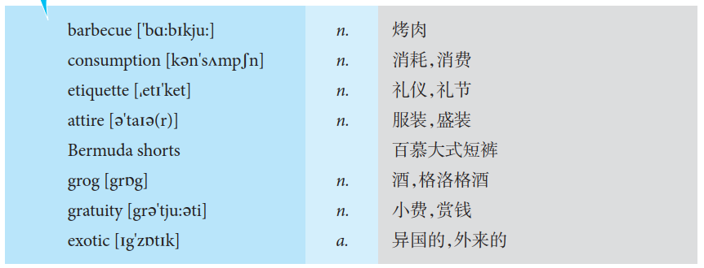
Vocabulary Power

Slide 25
Lesson Review
Task 1 Match each statement with the proper word.
1. barbecue
2. consumption
3. etiquette
4. attire
5. Bermuda shorts
6. grog
7. gratuity
8. exotic
A. in or from another country or part of the world
B. short pants that end at the knee
C. a meal cooked out of doors over an open fire
D. expenditure on goods and services for final personal use
E. clothing of a distinctive style or for a particular occasion
F. a drink made by mixing a strong spirit, such as rum or whisky, with water
G. a relatively small amount of money given for services rendered
H. a set of customs and rules for polite behaviour, especially among
a particular class of people or in a particular profession

Slide 26
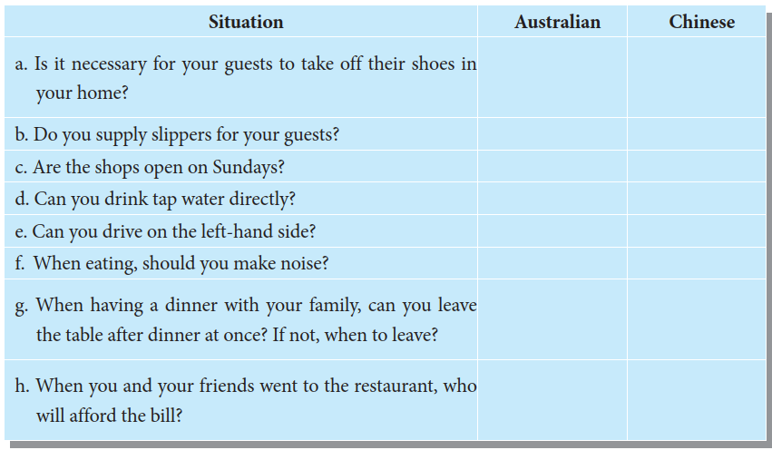
Task 2 How do you usually cope with the following situations? Please list the responses of the two countries respectively. Then you may easily find out their similarities and differences.
✔
✔
✔
✔
✖
✔
✔
✖
✔
✖
✔
✖
✖
After you have cleaned the table
✖
The elder finish the meal, then you can leave
AA
You pay for the bill

Slide 27
Task 3 Oral Presentation
If invited to a barbecue in Australia, what are you expected to wear and to bring with you? And what about the greetings?
Australians have a genuine love of barbecue. The barbecue party is also a place for people to communicate with each other, so I think it is the most important to dress simply and comfortably. Bring wine or flowers will be lovely.

Slide 28
Section B
Broadening My Horizon

Slide 29
Studying in Australia
TAFE Education in Australia
TAFE stands for“Technical and Further Education”.TAFE education has been regarded by some to be a second or third option when it comes to studying in Australia. This idea will be quickly dispelled when you look at the sheer quality and variety of courses available in Australia’s TAFE institutions, whose main objective is to facilitate an environment in which world-class vocational education and training is provided for students with a clear idea of their career path.
Think it over about which academic course is right for you.
You can select the area you would like to study in from the list below:

Slide 30
1. The Diploma in Business is the equivalent of the first year of a Bachelor of Commerce or Bachelor of Business Administration degree and allows you to enter the second year of your chosen degree once successfully completed.
2. The Diploma in Information Technology is the equivalent of the first year of a Bachelor of Information and Communication Technology, Bachelor of Internet Science and Technology or Bachelor of Computer Science degree and allows you to enter the second year of your chosen degree once successfully completed.
3. Foundation Studies are an accredited alternative to an Australia Year 12 qualification. Successful completion allows you to enter the first year of your chosen degree course.
It is offered as a two-session (8 months) or 3-session (12 months) course. Entry to Foundation Studies will depend on your final grades and your level of English.

Slide 31
How to choose a course?
Picking a course to study is very difficult for many prospective Australian students. Every course is different, from the diversity of the subject matter to the diversity of students in the class with you, and the future job opportunities that could come out of the course that you complete. The following points are things to take into consideration when you are thinking about what course you want to apply for:
Research: Be sure to conduct research and think about what you will be learning.
Subject Matter: Study something that you have an interest in.

Slide 32
Course Work: Different programs range in the amount of course work assigned to students. Learn how and what kind of learning will be taking place. For example, is your course research intensive?
How long is your course: Diplomas take around two years and Bachelor’s degrees take around three to four years. As far as going for double degrees, honor courses, and part-time programs, these will take longer to complete.
Study Abroad Opportunities: Does your course or future school allow you to study abroad or host exchange programs?
Course and School Quality: Besides the subject matter you should strive for a school that has experienced and recognized teachers and programs.

Slide 33
Entry Difficulty: Competitive courses are harder to get accepted and have tough criteria for admitting students. Find out the different levels of criteria from various courses and schools.
Course/School Cost: One of the most important things to look at is whether or not you can afford your course and all the other additional costs that go along when attending school. However, there are many financial aid options where a student can pay back his/her loans after he/ she complete his/her degree. Estimate how much debt you will have after graduating. The cost for students wanting to study in Australia depends on what level of education the student is pursuing. Overall living expenses and tuition cost in Australia are lower than cost of studying in the USA or the UK.

Slide 34
Future Job Opportunities: Courses like dental and hotel management pretty much set you up to get a good job within that field of work. Courses in arts and philosophy have a broader job opportunity.

Slide 35
Vocabulary Power

Slide 36
Lesson Review
Task 1 Match each statement with the proper word.
1. diversity
2. assign
3. intensive
4. criteria
5. tuition
A. to give out or allot a task, problem, etc.
B. the money that you pay to be taught, especially in a college or university
C. a standard by which something can be judged or decided
D. the state or quality of being different or varied
E. involving a lot of work or activity done in a short time

Slide 37
Task 2 Choose one exclusively from the two options for each sentence.
1. We have nothing against diversify/diversity; indeed, we want more of it.
2. They secure their degrees by slogging through an intensive/intense 11-month course.
3. Angela’s$7,000 tuition/charge at University this year will be paid for with scholarships.
4. In her study, participants were randomly took/assigned to two groups.
5. Each of us will have our own way/criteria for success.
diversity
intensive
tuition
assigned
criteria

Slide 38
Task 3 Surfing the Internet.
Suppose you’ll graduate from the college in two months and further your studies in Australia. Find all the information you need online for an Australian education which will suit you and share your plans with your classmates.

Slide 39
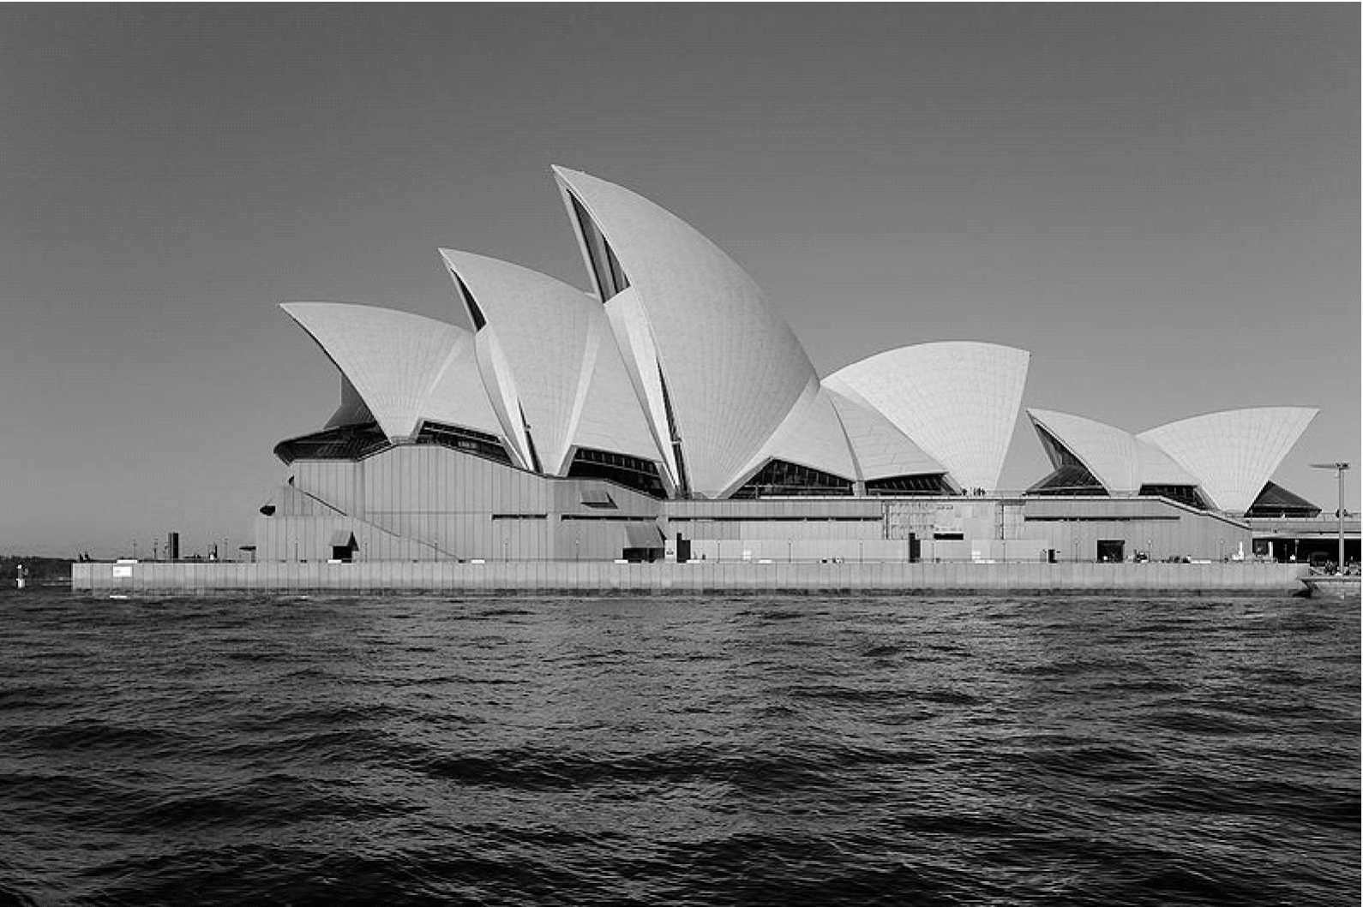
Symbols of Australia
1. The Sydney Opera House
The Sydney Opera House is a multi- venue performing arts centre on Bennelong Point[1] in Sydney, Australia. It was conceived and largely built by Danish architect Jorn Utzon[2], who, in 2003, received the Pritzker Prize[3], architecture’s highest honor. The citation stated:
“There is no doubt that the Sydney Opera House is his masterpiece. It is one of the great iconic buildings of the 20th century, an image of great beauty that has become known throughout the world — a symbol for not only a city, but a whole country and continent.”

Slide 40
The Sydney Opera House was made a UNESCO[4] World Heritage Site on 28 June, 2007.
It is one of the 20th century’s most distinctive buildings and one of the most famous performing arts centres in the world.
Contrary to its name, the building houses several separate venues rather than a single opera theatre — the two main venues, the Opera Theatre and the Concert Hall, being housed in the two larger sets of shells. The Sydney Opera House is a major presenting venue for Opera Australia, the Australian Ballet, the Sydney Theatre Company and the Sydney Symphony, as well as hosting many touring productions in a variety of performance genres, and is a major tourist attraction.

Slide 41
The Sydney Opera House is a modern expressionist design, with a series of large precast concrete“shells”,each composed of sections of a hemisphere of the same radius, forming the roofs of the structure, set on a monumental podium. The building covers 1.84 hectares of land and is 183 metres long and 118 metres wide at its widest point.
2. The Great Barrier Reef [5]
The Great Barrier Reef is the world’s largest coral reef system composed of over 2,900 individual reefs, an area of approximately 207,000 square kilometers. It consists of more than 350 colorful corals in various shapes. Part of it has now been designated as a Marine park. The reef is located in the Coral Sea, off the coast of Queensland in northeast Australia.
The Great Barrier Reef can be seen from outer space and is the world’s biggest single structure made by living organisms. This reef structure is composed of and built by billions of tiny organisms, known as coral polyps.

Slide 42
The Great Barrier Reef supports a wide diversity of life, and was selected as a World Heritage Site in 1981. It was labeled as one of the 7 natural wonders of the world.
The Great Barrier Reef supports a diversity of life, including many vulnerable or endangered species, some of which may be endemic to the reef system. About thirty species of whales, dolphins, and porpoises have been recorded in the Great Barrier Reef. Six species of sea turtles come to the reef to breed. Over 200 species of birds are attracted to the reef or nest or roost on the islands. More than ten species of sea snakes and more than 1,500 species of fish live on the Great Barrier Reef. About four hundred species of corals, both hard corals and soft corals are found on the reef.

Slide 43
The most significant threat to the Great Barrier Reef is climate change. Mass coral bleaching events due to rising ocean temperatures occurred in the summers of 1998, 2002 and 2006, and coral bleaching will likely become an annual occurrence. Climate change has implications for other forms of life on the Great Barrier Reef as well — some fish’s preferred temperature range leads them to seek new areas to live in, thus causing chick mortality in seabirds that prey on the fish. Climate change will also affect the population and available habitat of sea turtles.
Another key threat faced by the Great Barrier Reef is pollution and declining water quality. The rivers of north eastern Australia provide significant pollution of the Reef during tropical flood events with over 90% of this pollution being sourced from farms. Farm run-off is polluted as a result of overgrazing and excessive fertiliser and pesticide use.

Slide 44
Human activity in the Reef areas is also a threat to the Great Barrier Reef. In 2003, the previous Australian Government and Queensland Government, in partnership with a wide range of industry and community groups, developed the Reef Water Quality Protection Plan (the Reef Plan) as a combined effort to protect the Reef.

Slide 46
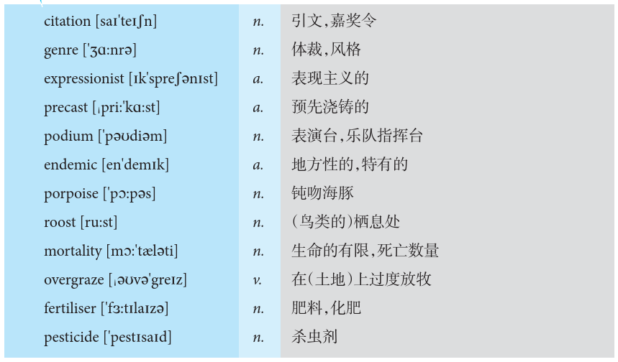
Vocabulary Power

Slide 47
Lesson Review
Task 1 Match each statement with the proper word.
1. citation
2. genre
3. expressionist
4. precast
5. podium
6. pier
7. endemic
8. porpoise
9. roost
10. mortality
11. overgraze
12. fertiliser
13. pesticide
A. excessive feeding animals like cow or sheep
B. a sea animal that looks like a large grey fish
C. loss of life, as in war or disaster
D. a place where birds sleep
E. any substance, such as manure or a mixture of nitrates, added to soil or water to increase its productivity
F. chemical which farmers put on their crops to kill harmful insects
G. regularly found in a particular place or among a particular group of people and difficult to get rid of
H. a platform built out from the shore into the water and supported by piles to provide access to ships and boats
I. an official award as for bravery or service usually given as formal public statement
J. an artist who is an adherent of expressionism
K. of some building materials made into blocks ready to use
L. a small platform that a person stands on when giving a speech or conducting an orchestra, etc.
M. a style of expressing yourself in writing

Slide 48
Task 2 What is the size of the Sydney Opera House?
The building covers 1.8 hectares (4.5 acres) of land.

Slide 49
Task 3 Please read the following news supplied by Tourism Queensland in Australia, then try to answer the following questions.
About the Best Job in the World
After a worldwide search, Ben Southall was chosen as Tourism Queensland’s Islands Care- taker, or what we like to call“the Best Job in the World”.The role is a newly created position de- signed to help promote the Islands of the Great Barrier Reef to the world.
Ben was selected from more than 34,000 people from around the globe who applied for the Best Job in the World. He will work for six months exploring the Islands of the Great Barrier Reef and report on his travels through regular blog posts.

Slide 50
Task 3 Please read the following news supplied by Tourism Queensland in Australia, then try to answer the following questions.
Applications for the job opened in January 2009, with would-be caretakers sending in 60- second videos showing their creativity and skills. From a shortlist of 50 applicants, Ben was amongst the final 16 applicants who travelled to Queensland in early May for the final selection process.
Ben will immerse himself in life above and below the Islands of the Great Barrier Reef. A keen diver and sailor, he’s going to experience the full wonder and ecological diversity of the reef and islands. And you can follow Ben’s adventures through this blog!

Slide 51
Task 3 Please read the following news supplied by Tourism Queensland in Australia, then try to answer the following questions.
Questions:
1. What is“the best job in the world”according to the news above?
2. Who got“the best job in the world”according to the news above?
3. How long will Ben work there?
Help promote the islands of the Great Barrier Reef to the world.
Ben.
Six months.

Slide 52
Task 4 Oral Presentation
Describe a building that you enjoy the time being there.
You should say:
• where it is;
• what it looks like;
• when you went there.

Slide 53
Task 4 Oral Presentation
Wenfeng Tower, built in 1420, is located in the southern of Anyang City. During the Ming and Qing dynasties, people came to the tower to worship the God of Heaven and pray for a good harvest. Nowadays, it serves as a museum of history. Murals of Wenfeng Tower give visitors a feel for the great artistic achievements of ancient Chinese civilization. In a word, I think the Wenfeng Tower is the most interesting building, and it is the oldest building in my hometown.

Slide 54
Section C
Reading for Pleasure

Slide 55
Kangaroos and Koala Bears
Biodiversity is the variety of life: the different plants, animals and micro- organisms, their genes and the ecosystems of which they are a part. Australia is one of the most diverse countries on the planet. Australia has about 12,000 species of plants. It is home to many animals, some of which are found nowhere else in the world. The kangaroo is one of Australia’s most iconic animals, and most species are endemic to Australia.

Slide 56
Kangaroos
Kangaroos, and their close relatives, vary greatly in size. There are at least 55 different types (called species) of kangaroos. These species are found naturally in the wild only in Australia and New Guinea[1], although feral populations of some species have been introduced in New Zealand, Great Britain and Hawaii.
The best- known Macropodidaes[2] are kangaroos, which is why the word“kangaroo” is often used to describe any members of this family. We use “kangaroos” in this text whenever these animals are being discussed in general.

Slide 57
Kangaroos of all sizes have one thing in common—powerful back legs with long feet. They are distinguished from other animals by the way they hop on these strong back legs. Only a few other small mammals, such as hopping mice, do this.
A tiny newly born kangaroo (usually less than 25 mm long) moves unaided into its
mother’s pouch and attaches itself to one of the four teats. During the early stages of
pouch life the young is permanently attached to the teat, but as it matures and begins to grow hair it also develops the ability to release and reattach itself to the teat.

Slide 58
In the late stages of pouch life, once it has a thin covering of fur, the young one begins to explore the outside world for increasing lengths of time until eventually it is old enough to be excluded permanently from the pouch. Complete weaning may take a number of months more after the young has permanently left the pouch. If the mother gives birth during this time, the newborn young will attach itself to a different teat from that being used by the older young. It is remarkable that when this happens the mother produces two different kinds of milk for the two different-aged young.

Slide 59
Koalas
The koala is commonly known as the koala bear, but in fact is not related to bears at all. It is a marsupial and a native of eastern and southeastern Australia. Marsupials are a group of animals that raise their young in pouches, and include kangaroos, wallabies, wombats, possums, and opossums. The name koala bear came about because the koala looks like a teddy bear, and the name is still used widely, but is discouraged in Australia because of the inaccuracy.

Slide 60
The koala has a thick plushy fur coat, large furry ears with long white hairs on the
tips, and long limbs. The koala has large sharp claws, and ridged skin on the bottom of its feet for traction, both of which make it a good tree climber. Weight varies from about 31 pounds for a large male, to about 11 pounds for a small female. The koala’s five fingers are arranged with opposable thumbs, providing better gripping ability, and it is one of the few mammals, other than primates, that have fingerprints.

Slide 61
Koalas are very slow moving animals. Their high fiber, low nutrient diet gives them a slow metabolic rate and they sleep around 19 hours a day. Koalas live in trees to keep safe from predators, even sleeping there, with their backs firmly pressed into the forks of branches. They tend to sleep throughout the day, and start to move around after sunset, for around five hours or so, feeding for three of those hours. Their diet consists almost entirely of eucalyptus leaves, so these trees become their home and their food supply. They travel on the ground only to move from one tree to another. They seldom drink water, getting their needs from the eucalyptus leaves. They eat twelve different varieties of eucalyptus, and in some regions will also eat mistletoe, tea tree, wattle, and paper-bark tree, if available.

Slide 62
Koalas breed once a year. Females are mature at three years old, males at four.
Gestation lasts around 35 days, and only one baby, called a Joey, is born at a time. The Joey is blind, hairless, less than one inch long and weighs little more than 1/32 of an ounce. The Joey crawls from the birth canal into its mother’s backward facing pouch completely unaided, relying on its sense of smell, strong forelimbs and claws. In this safe haven it attaches itself to one of the two nipples, drinks milk, and grows for the next six months. The koala Joey will then leave the pouch, but return for safety and to sleep until it is too big to get in, after which time they often ride on their mother’s back, holding onto her fur with strong hands and feet. When they are about a
year old they can live in trees.

Slide 63
Koalas can live as long as 17 years, however male life expectancy is less than 10
years due to fighting injuries or death from dogs and cars when crossing open ground to a new tree or area. Females generally live longer and, if healthy, a female will reproduce for 12 years. The Australian Government lists the koala as a priority species for conservation status assessment, and, as with most native Australian animals, the koala cannot be kept as a pet in Australia or anywhere else.

Slide 65
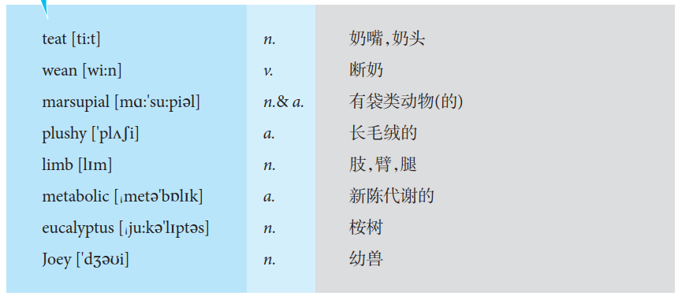
Vocabulary Power

Slide 66
Lesson Review
Task 1 Match each statement with the proper word.
1. teat
2. wean
3. marsupial
4. plush
5. limb
6. metabolic
7. Joey
A. any young animal
B. of or relating to metabolism
C. the small projection of a mammary gland
D. to gradually stop feeding a baby or young animal with its mother’s milk and start feeding it with solid food
E. one of the jointed appendages of an animal used for locomotion or grasping: arm; leg; wing; flipper
F. a thick soft material like velvet, used especially for carpets and to cover furniture
G. mammal of which the females have a pouch containing the
teats where the young are fed and carried

Slide 67
Task 2 Fill in the blanks of the following paragraph.
Koalas’high fiber, low nutrient diet gives them a slow metabolic rate and they sleep around ________ hours a day. Koalas live in trees to keep safe from predators, even sleeping there, with their backs firmly pressed into the forks of branches. They tend to sleep _____________ the day, and start to move around after ________, for around ________ hours or so, feeding for ________ of those hours. They ________ drink water. Females are mature at ________ years old, males at four. Koalas can live as long as ________ years. And they cannot be kept as a pet in Australia or anywhere else.
19
throughout
sunset
five
three
seldom
three
17

Slide 68
Christmas in Australia
There is no one standard Australian Christmas: it’sa family time, as it is everywhere. People came to Australia from many different countries and brought their traditions with them. Cards and presents are exchanged. Carols are sung, and candlelight events are held in many communities. Church services are held during and at Christmas, including midnight services on Christmas Eve[1]. Christmas trees and Christmas lights decorate homes and businesses and streets. Many charities have Christmas appeals and activities.
Santa Claus/Father Christmas[2] is as popular as he is throughout the world, though he is sometimes pictured in swimming costume and a cool drink may be left out for him because of the warm weather. There are Santas in shops and at Christmas events, and many shopping centers have photo-with-Santa places.

Slide 69
As with Christmas anywhere, families have their own traditions. Given that it’s summer here, they may be the traditional family relay in the swimming pool, or the traditional family water pistol fight, or the traditional family game of backyard cricket.
The Boxing Day Test Match (cricket game beginning on the day after Christmas) and the beginning of the Sydney to Hobart Yacht race on Sydney Harbor (also on Boxing Day) are two sporting events of significance which happen each Christmas. Other people spend Boxing Day travelling to their summer holiday destinations.
School finishes a week before Christmas for the summer break and resumes after Australia Day on 26 January.

Slide 70
Many Christmas decorations and symbols are the same as you find in the U.S. or Europe: holly, snow scenes, goose, ham and plum puddings and so on, even though these don’trepresent the reality of Christmas weather/plants in many parts of Australia. December is one of the hottest months in Australia, so outdoors sports like swimming, surfing and fishing are common, and easy cold meat & salad dominates most meals.
Houses aren’t as heavily decorated with greenery as in parts of the U.S., perhaps because, being in summer, you can spend time outdoors. Some people put Christmas wreaths on their front doors. In some areas there is a long tradition of every house in the street having Christmas lights, and people come to see the decorations.

Slide 71
Real holly and mistletoe are hard to find, as they are out of season, but NSW Christmas bush and Christmas bells are two native plants used for decoration which are in season.
Businesses and shops close on Christmas Day and Boxing Day, however, the major retail centers open after Christmas for clearance sales on all Christmas stock that did not sell. This has become an important part of Christmas for many bargain shoppers. Some people now wait to buy their gifts after Christmas at the sales. Those families that can afford it head for coastal resorts and beachside caravan parks for the holiday period.

Slide 73
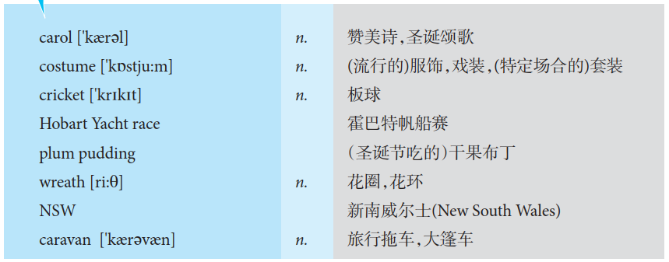
Vocabulary Power

Slide 74
Lesson Review
Task 1 Match each statement with the proper word.
1. carol
2. costume
3. cricket
4. plum pudding
5. wreath
6. caravan
A. the attire worn in a play or at a fancy dress ball
B. a game played with a ball and bat by two teams of 11 players; teams take turns trying to score runs
C. a rich steamed or boiled cake-like pudding
D. flower arrangement consisting of a circular band of foliage or flowers for ornamental purposes
E. joyful religious song celebrating the birth of Christ
F. It’s a vehicle without an engine that can be pulled by a car or van. It contains beds and cooking equipment so that people can live or spend their holidays in it.

Slide 75
Task 2 Please fill in the blanks of the following statements.
1. Santa Claus is as popular as he is throughout the world, though he is sometimes pictured in _________ costume and a cool drink may be left out for him because of _________________.
2. In some areas there is a long tradition of every house in the street having ________________, and people come to see the decorations.
3. Businesses and shops _________ on Christmas Day and Boxing Day.
swimming
the warm weather
Christmas Lights
close

Slide 76
Task 3 Oral Presentation
Describe an interesting animal.
You should say:
• what it looks like;
• when you saw/knew it for the first time;
• where it lives;
• why it is interesting.

Slide 77
Task 3 Oral Presentation
I am ever a cat slave since the watchful little kitty spot me lost in the street and was kind enough to take me home and allow me to live with him. From that fateful day on, (oh by the way, it was around 3 months ago) my life has gone through a great change and is coming to find a new meaning: loyalty.
He calls himself “jianjian” because in Chinese “jian” means “pick”, which obviously is to commemorate his good Samaritan act towards me. So I will share stories about some daily routines in our love-hate relationship.
After many sleepless nights with him during our failed trials of sleeping together, I was forced to let him sleep in the dining room. But the thing is, every night when it is time for me to place him in the bed in the dinning room, he seems to feel it and refuse it. So he will play hide and seek like crazy with me in the living room. Sometimes I win and it cost me one to two hours sleep time, sometimes I lose and he will sleep on my chest like a rock and wake me in the early morning.

Slide 78
Task 3 Oral Presentation
You know today I waked up from a sweet dream by almost unbearable scratch sound on my room door, and I peacefully drowned out my inner voice: go kill the bugger, put on my smiling face while feed him, and then set out. And I know what Jianjian will do to his territory for sure: upset every bottle of flowers, empty every trash bin and spoil all foods he can reach, finally, and turn the house into a great adventure land.

Slide 79
Chapter Revision
Task 1 Do the following statements agree with the information given in Reading?
TURE(T) if the statement agrees with the information
FALSE(F) if the statement contradicts with the information

Slide 80
( ) 1. Australia is a continent between the Atlantic Ocean and the South Pacific Ocean.
( ) 2. The dry season in Australia usually between November and April.
( ) 3. Australia was once a British colony.
( ) 4. Australia is a main farm product exporter.
( ) 5. Mining is a key industry sector in Australia.
F
F
T
T
T

Slide 81
Task 2 Choose the best one of the four choices for each sentence.
1. Which of the following cloth is not suitable for business function?
A. casual clothing B. dark business suit
C. tie D. blouse
2. It is good manner to greet with a ________ in Australia.
A. kiss B. curse C. handshake D. nose-touching
3. TAFE is a kind of ________ education in Australia.
A. secondary B. vocational
C. academic knowledge D. home-based

Slide 82
4. Sydney Opera House has the following characteristics except ________.
A. it is a multi-venue performing art centre
B. it was built by Jorn Utzon
C. it is a UNESCO World Heritage Site
D. it is a traditional expressionist design
5. The Greater Barrier Reef has the following characteristics except ________.
A. it is the world’s second largest coral reef system
B. it is located off the coast of Queensland
C. it is the world’s biggest single structure made by living organisms
D. it supports various of lives

Slide 83
6. The main threats to the Greater Barrier Reef are the following except ________.
A. decline water quality
B. climate change
C. scientist research
D. pollution
7. Biodiversity is a variety of life except ________.
A. private car B. different plants
C. animals D. micro-organisms

Slide 84
8. ________ are the most native animals in Australia.
A. Pandas B. Snakes
C. Kangaroos D. Gold fish
9. Which of the following habits is not the tradition of Christmas in Australia?
A. People exchange cards and presents.
B. People held candlelight events in the community.
C. Parents give lucky money to their children.
D. Christmas trees and Christmas lights decorate homes and streets.

Slide 85
10. School summer break starts from ________.
A. 26, January B. a week before Christmas
C. 30, November D. a week after Christmas

Slide 86
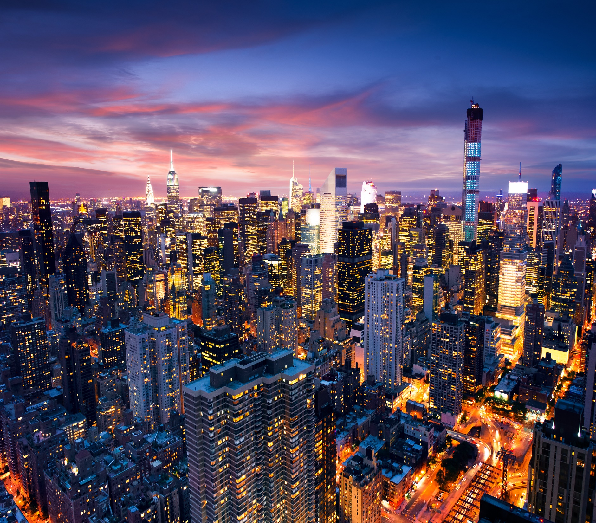
Thank you

